Slide 1

NeRF Automated Data Capture Rig
By:
Om Gaikwad
Ameya Deshmukh
Advisor:
Joe Moeller (Kinetic Vision)

Slide 2

Purpose and Goals
To revolutionize the way 2D visual data is converted into 3D representations.
Speed and Efficiency
High Resolution Outputs
Automated Feature Detection
Machine Learning Integration
Robustness to Varied Environments
Notes:
Goals:
Speed and Efficiency: Develop algorithms and technologies that significantly reduce the time required for 2D to 3D conversion.
High-Resolution Output: Achieve the capability to generate 3D models with high resolution and detail from 2D inputs.
Adaptability: Create a system that can handle a wide range of input sources, from photographs to video streams, without compromising quality.
Automated Feature Detection: Implement advanced feature detection and recognition techniques to automate the conversion process as much as possible.
Realism and Artistry: Enable the system to produce 3D representations that are not only accurate but artistically pleasing, enhancing creative applications.
Cross-Platform Compatibility: Ensure compatibility with various platforms, including desktop, mobile, and cloud-based systems.
Robustness to Varied Environments: Develop the capability to handle different lighting conditions, angles, and environments for versatile use cases.
Machine Learning Integration: Incorporate machine learning and deep learning techniques to continually improve the conversion process through data-driven insights.

Slide 3
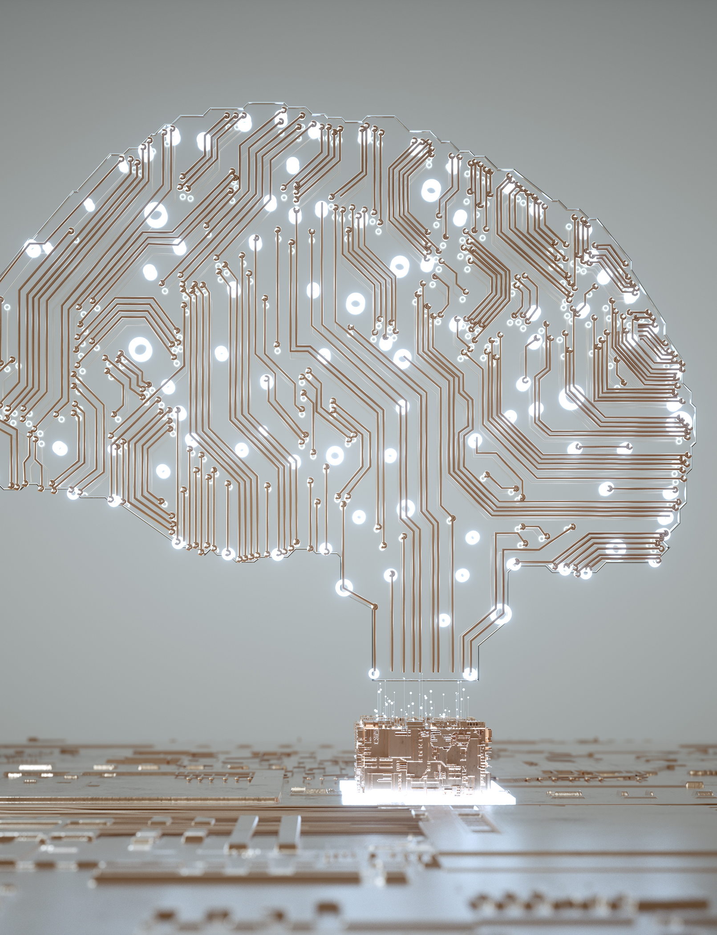
Project Abstract
The NERF Data Capture project is a groundbreaking endeavor aimed at revolutionizing the conversion of 2D visual data into highly accurate 3D representations. Our core objectives include enhancing the efficiency of this conversion process, achieving high-resolution 3D output, and ensuring adaptability across a multitude of input sources. We aim to automate feature detection, provide realism and artistry in our 3D models, and offer cross-platform compatibility. Our robust system can adapt to varied environments and leverages machine learning to continually improve results. NERF Data Capture is poised to provide a versatile, accessible, and artistically compelling solution for professionals and enthusiasts alike.

Slide 4

UseR Stories
As an e-commerce business owner, I want to automatically convert 2D product images into high-quality 3D models, so that I can enhance the online shopping experience for my customers and increase sales through interactive product views.
As a marketing manager, I want to easily create 3D models of our products for use in advertising and promotional materials, so that I can showcase our products more effectively and attract a larger audience.
As a computer vision researcher, I want to access a dataset of 3D product models generated by the automated rig, so that I can use it for training and evaluating advanced computer vision algorithms, which will benefit various research applications.
As a software developer, I want to integrate the automated data generation rig into our company's e-commerce platform, so that I can provide real-time 3D product views to our customers, improving their online shopping experience.
As a consumer, I want to explore products in 3D on e-commerce websites, so that I can make more informed purchasing decisions and have a better understanding of the products I'm interested in.

Slide 5
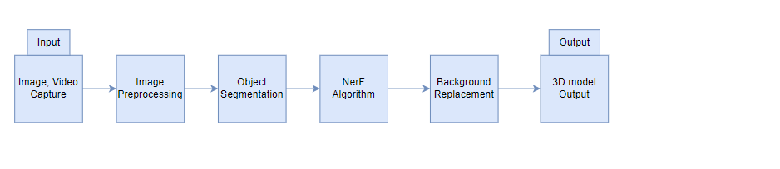
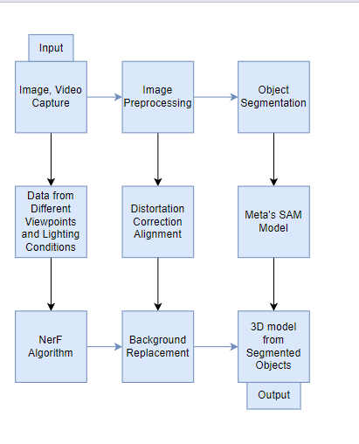
Design Diagrams

Slide 6
Major project constraints
1. Economic Constraints
Cost influenced by software choice.
Resources depend on funding source.
Potential economic growth opportunities.
2. Ethical Considerations
Address privacy and sensitivity.
Ensure a positive impact.
Implement safeguards and consent.
3. Legal Restrictions
Copyright and proprietary data.
Protect intellectual property.
Comply with data protection laws.
4. Privacy and Security
Minimize risks (malware, unauthorized access).
Protect private information.
Use strong security measures.
5. Social Impact
Enhance lives through 3D applications.
Public benefit and accessibility
6. Environmental Concerns
Evaluate energy consumption.
Mitigate environmental impact.
7. Diversity and Culture
Address language and cultural issues.
Promote inclusiveness.
Notes:
Project Constraints Our NERF project, focused on the conversion of 2D images to 3D, faces a multitude of constraints that span various critical topical areas, necessitating careful consideration during the design and execution phases. Economic constraints should come first. The project's cost will be heavily influenced by whether freeware, shareware, or commercial software packages are used for image conversion. Furthermore, the resources available will be determined by where the money is coming from— personally or through a corporate organization. Furthermore, the project's economic growth potential should not be overlooked; it might lead to new job opportunities or 3D technical applications, both of which would be helpful to the economy. Ethical considerations are especially essential when dealing with the alteration of private or sensitive pictures. It is critical to ensure a positive or neutral impact while also protecting people's privacy and rights. Safeguards and precautions must be in place to protect against ethical breaches, such as obtaining informed consent before converting images. Legal restrictions are another important concern. Legal issues might arise if the project uses copyrighted or proprietary image data for conversion. The protection of intellectual property rights and the creation of techniques for resolving such disputes are both necessary. Additionally, according to data protection laws and guidelines is essential for avoiding legal problems, especially when it comes to privacy issues. Privacy and security restrictions are also significant considerations. It is crucial to reduce risks like malware, viruses, and unauthorized access to 3D data that has been changed. Protecting the private information included in images is equally essential. Strong security measures and encryption methods should be used to safeguard the project from any threats. The NERF project's potential social impact and value cannot be overstated. It may give rise to a technology that enhances people's lives through creative 3D conversion. This might include applications for the public benefit, such as assisting the blind or enhancing accessibility. The assessment of how the project helps society and enhances people's quality of life should be at the centre of its design and implementation. Despite the fact that they are primarily concerned with image conversion, environmental considerations should not be overlooked. If the project incorporates hardware components, the energy consumption and environmental impact should be maintained to a minimum. Potentially detrimental consequences, such as an increase in electronic waste, should also be assessed and mitigated. Finally, the design of the project may be influenced by diversity and cultural factors. Language barriers and cultural sensitivities must be addressed to ensure that the solution is inclusive and accessible across all groups and locales. The initiative will be more successful and popular if it actively promotes diversity and cultural inclusiveness. Finally, successfully managing these restrictions is essential to the NERF project's success. Its design will be influenced by a thorough examination and study of economic, professional, ethical, legal, security, social, environmental, diversity, and cultural factors, ensuring that it complies with technology goals while upholding the principles and obligations of a broader society.

Slide 7
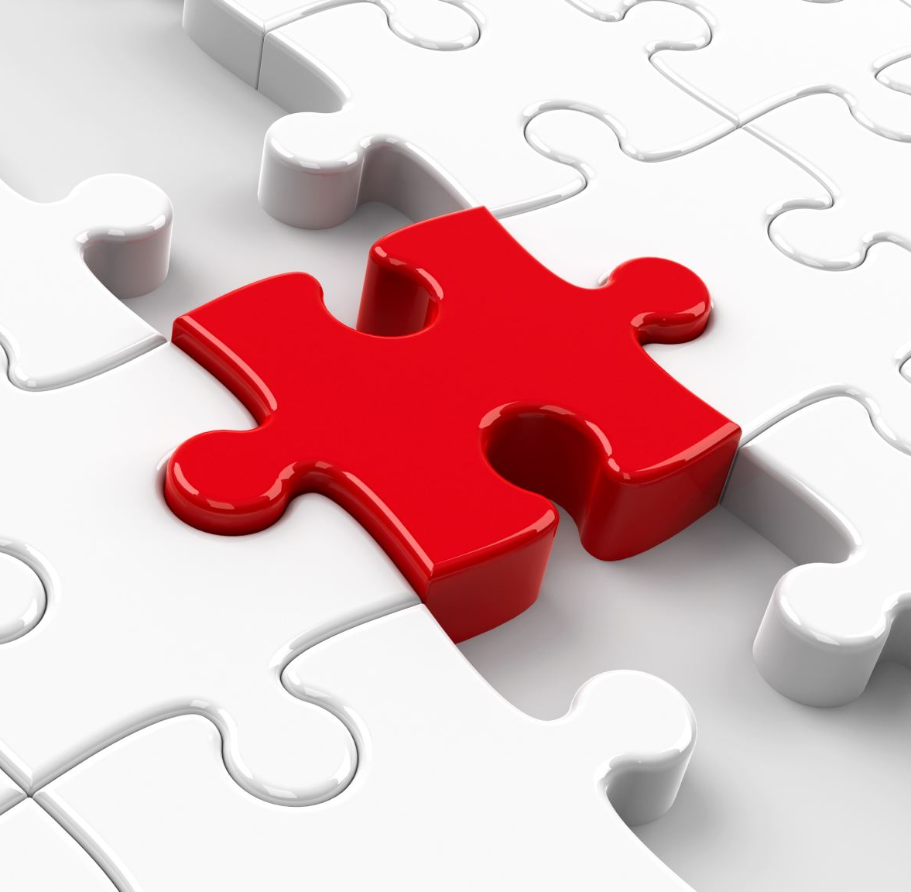
Project progress
Our project, centered around implementing the NeRF algorithm for 2D to 3D conversion, is progressing smoothly. We've initiated integrating the NeRF model, and meticulously documented our project plan, setting the stage for imminent implementation. With our clear vision, collaborative teamwork, and a shared commitment to pushing the boundaries of technology, we are on track to create a platform that has the potential to reshape industries reliant on 3D modeling and visualization.

Slide 8

Expected accomplishments
Primary Objective: Our main goal is to seamlessly integrate the NeRF algorithm into our project, enabling the conversion of smartphone-captured photos and videos into immersive 3D representations.
Complex Challenge: This task involves refining machine learning models, preprocessing data, optimizing algorithms, and rigorous testing, highlighting the complexity of our mission.
Unwavering Determination: Despite the challenges, our team remains resolute in pushing the boundaries of 2D to 3D conversion, fueled by the transformative potential of our work.
Revolutionary Impact: We believe our project has the potential to revolutionize how we engage with visual media, reinforcing our commitment to this endeavor.

Slide 9
Division of work
Ameya | Om
Design and Hardware Componets | Calibrate Cameras
Rig Prototype | Meta’s SAM Model Implementation
Data Collection Protocol | NeRF Algorithm Implementation
Background Replacement Algorithm | Evaluate Model Quality
Data Preprocessing | Project Reporting
Documentation | User Interface Development
Testing | Testing
Notes:
Apart from this, the tasks that have been divided 50-50 are: Budget and Resource management, Noting Team Minutes, External Consultation, Timeline Management, Project Repository management

Slide 10

Expected demo at expo
Live 2D to 3D Conversion:
Visitors should be able to capture a photo or take a video with their smartphone at the expo. They can then pass these images or videos through our application. The application will perform real-time 2D to 3D conversion, and the resulting 3D models or scenes will be displayed on a large screen or a VR headset for attendees to explore and interact with.

Slide 11

Thank you

